Slide 1
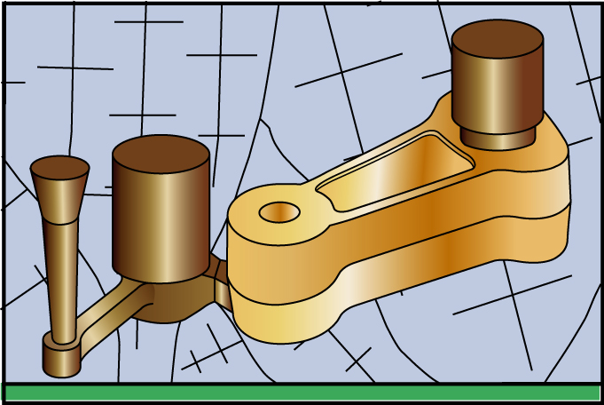
Fundamentals of Metal Casting

Slide 2
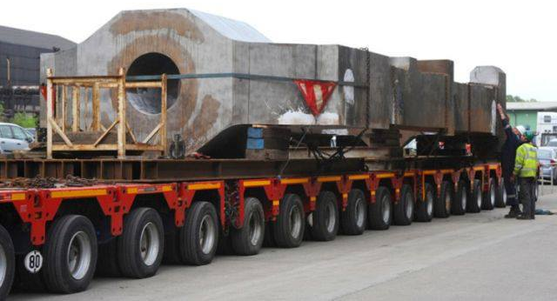
The castings measure 13 metres in length, 4.7m in width and 2m in height; Two massive castings weighing almost 600 tonnes collectively have started on a 4,000 mile journey from Sheffield to Venezuela. The castings have been made by heavy engineering firm Sheffield Forgemasters International (SFIL). They measure 13 metres in length, 4.7m in width and 2m in height and are two of the largest components that the 200-year-old steelworks has ever produced. At 290 tonnes each, the castings will create a largescale mill housing to roll plate steel for SMS Siemag, part of the construction and mechanical engineering group SMS. The castings form the outer frame of the rolling mill with a series of stacked rolls inside the housing, applying huge forces to roll the steel plate to a desired size. Production of the castings required Forgemasters to make a six ladle pours each with 100 tonnes of molten steel into a specially designed mould.

Slide 3
Solidification of Metals
After molten metal is poured into a mold, a series of events takes place during the solidification of the metal and its cooling to ambient temperature. These events greatly influence the size, shape, uniformity and chemical composition of the grains formed throughout the casting, which in turn influence the overall properties of the metal. The significant factors affecting these events are the type of metal, the thermal properties of both the metal and the mold, the geometric relationship between volume and surface area of the casting and the shape of the mold.

Slide 4
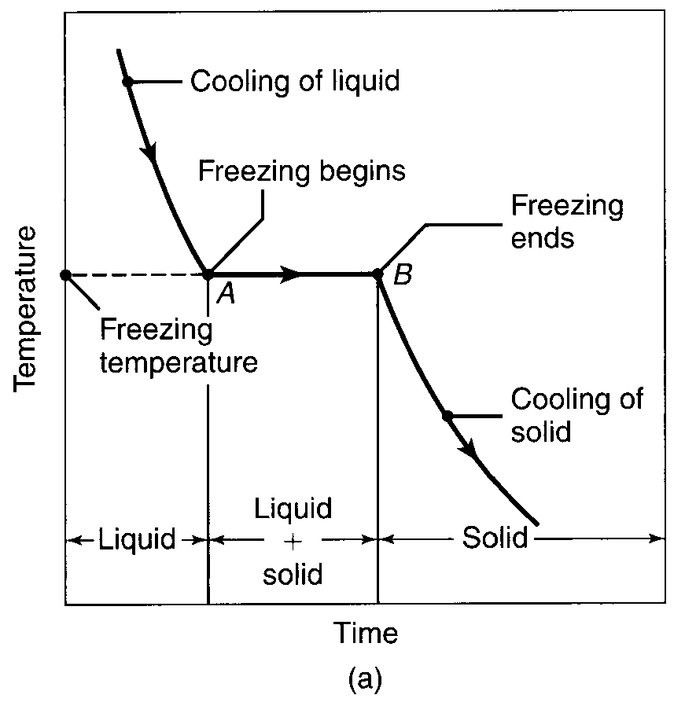
Solidification of Pure Metals
Since pure metal has a clearly defined melting point, it solidifies at a constant temperature, as shown in Fig., After the temperature of the molten metal drops to its freezing point, its temperature remains constant while the latent heat of fusion is given off. The solidification front (solid-liquid interface) moves through the molten metal from the mold walls in toward the center. The solidified metal, called the casting, is taken out of the mold and allowed to cool to ambient temperature.

Slide 5
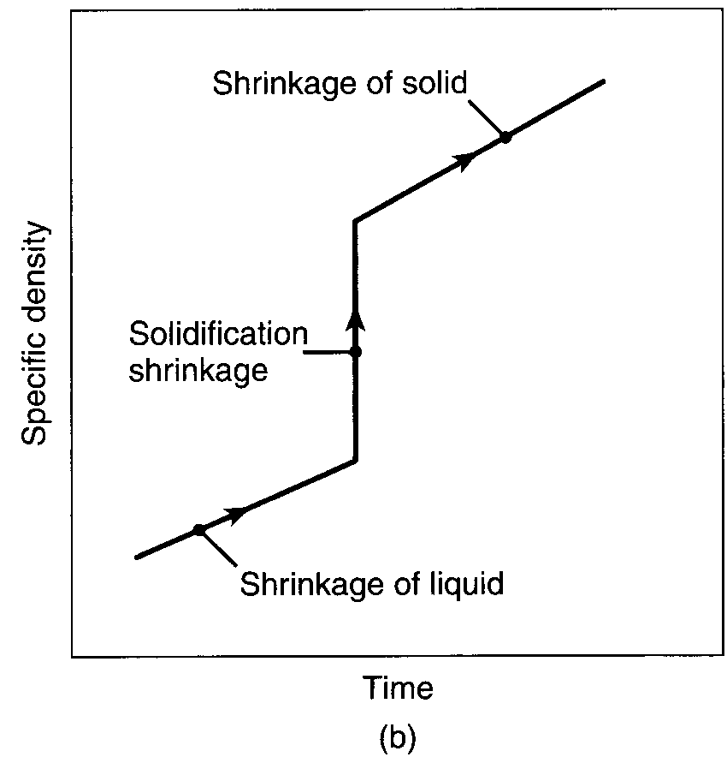
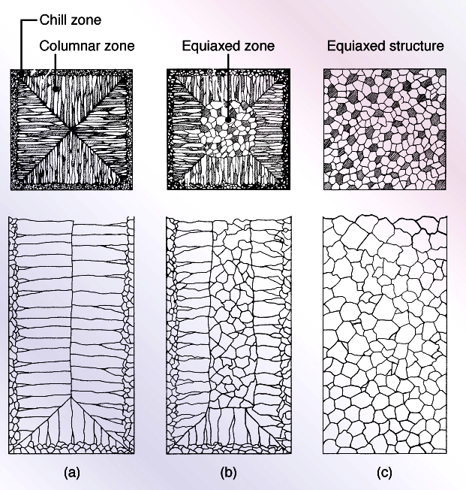
Metals shrink while cooling and generally also shrink when they solidify.
This is an important consideration, because shrinkage can lead to micro-cracking and associated porosity, which can in turn compromise the mechanical properties of the casting.
Schematic illustration of three cast structures of metals solidified in a square mold: (a) pure metals; (b) solid-solution alloys; and (c) structure obtained by using nucleating agents.

Slide 6
As an example of the grain structure that develops in a casting, Fig. shows a cross section of a box-shaped mold. At the mold walls, which are at ambient temperature or typically are much cooler than the molten metal, the metal cools rapidly and produces a solidified skin, or shell, of fine equiaxed grains. The grains generally grow in a direction opposite to that of the heat transfer out through the mold.

Slide 7
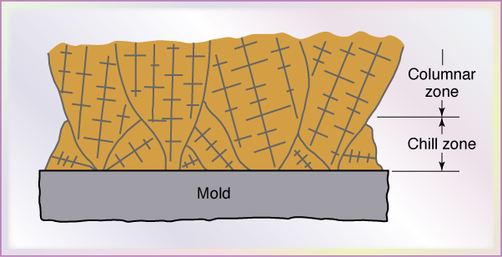
Those grains that have favorable orientation grow preferentially and are called columnar grains (Fig. 10.3). Those grains that have substantially different orientations are blocked from further growth. As the driving force of the heat transfer is reduced away from the mold walls, the grains become equiaxed and coarse. This process of grain development is known as homogenous nucleation, meaning that the grains (crystals) grow upon themselves, starting at the mold wall.
Figure 10.3 Development of a preferred texture at a cool mold wall. Note that only favorably oriented grains grow away from the surface of the mold

Slide 8
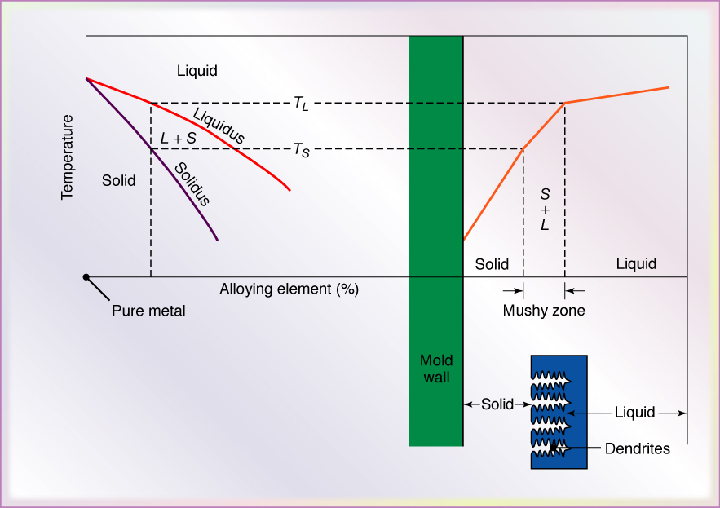
Alloy Solidification
Figure 10.4 Schematic illustration of alloy solidification and temperature distribution in the solidifying metal. Note the formation of dendrites in the mushy zone.

Slide 9
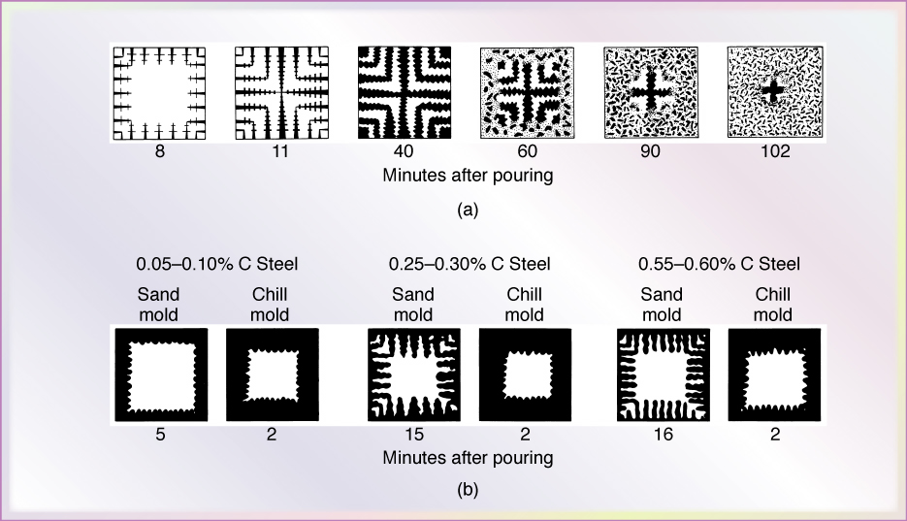
Solidification of Iron and Carbon Steels
Figure 10.5 (a) Solidification patterns for gray cast iron in a 180-mm (7-in.) square casting. Note that after 11 minutes of cooling, dendrites reach each other, but the casting is still mushy throughout. It takes about two hours for this casting to solidify completely. (b) Solidification of carbon steels in sand and chill (metal) molds. Note the difference in solidification patterns as the carbon content increases

Slide 10
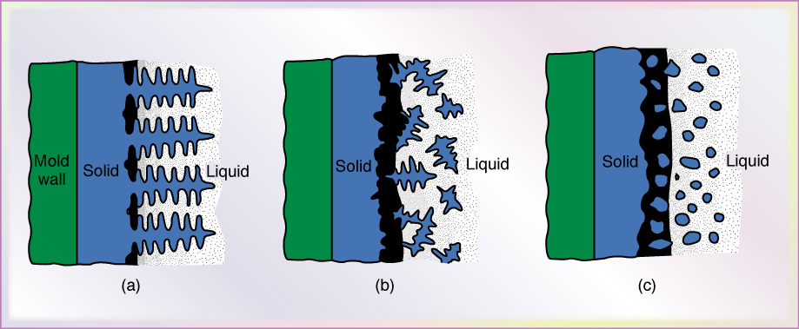
Basic Types of Cast Structures
Figure 10.6 Schematic illustration of three basic types of cast structures: (a) columnar dendritic; (b) equizxed dendritic; and (c) equiaxed nondendritic.

Slide 11
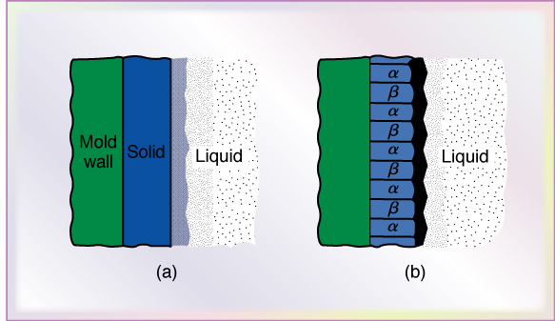
Cast Structures
Figure 10.7 Schematic illustration of cast structures in (a) plane front, single phase, and (b) plane front, two phase

Slide 12
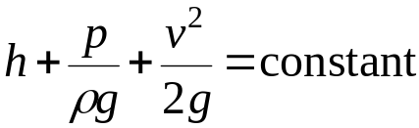

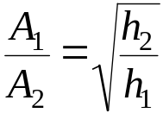
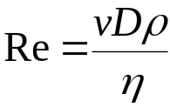
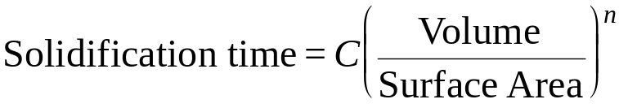
Fluid Flow and Solidification Time
Bernoulli’s theorem
Mass continuity
Sprue design
Reynolds number
Chvorinov’s Rule

Slide 13
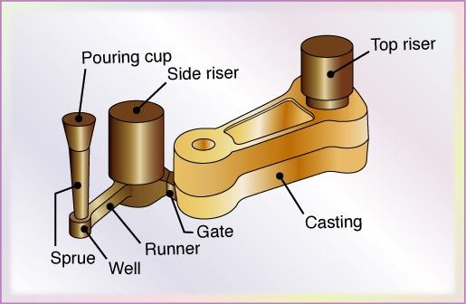
Fluid Flow
The molten metal is poured through a pouring basin or cup; it then flows through the gating system into the mold cavity. The sprue is a tapered vertical channel through which the molten metal flows downward in the mold. Runners are the channels that carry the molten metal from the sprue into the mold cavity or connect the sprue to the gate
Figure: Schematic illustration of a typical riser-gated casting.
Risers (also called feeders) serve as reservoirs of molten metal to supply any molten metal necessary to prevent porosity due to shrinkage during solidification. Although such a gating system appears to be relatively simple, successful casting requires proper design and control of the solidification process to ensure adequate fluid flow in the system.

Slide 14
For example, an important function of the gating system in sand casting is to trap contaminants (such as oxides and other inclusions) and remove them from the molten metal by having the contaminants adhere to the walls of the gating system, thereby preventing them from reaching the mold cavity. Furthermore, a properly designed gating system helps avoid or minimize problems such as premature cooling, turbulence, and gas entrapment. Even before it reaches the mold cavity, the molten metal must be handled carefully to avoid the formation of oxides on molten metal surfaces from exposure to the environment or the introduction of impurities into the molten metal.

Slide 15


Two basic principles of fluid flow are relevant to gating design: Bernoulli’s theorem and the law of mass continuity.
Bernoulli’s Theorem: This theorem is based on the principle of the conservation of energy and relates pressure, velocity, the elevation of the fluid at any location in the system, and the frictional losses in a system that is full of liquid. The Bernoulli equation is
Where h is the elevation above a certain reference level, p is the pressure at that elevation, v is the velocity of the liquid at that elevation, ρ is the density of the fluid and g is the gravitational constant. Conservation of energy requires that, at a particular location in the system, the following relationship be satisfied:
Where the subscripts 1 and 2 represent two different locations in the system and f represents the frictional loss in the liquid as it travels through the system. The frictional loss includes such factors as energy loss at the liquid-mold wall interfaces and turbulence in the liquid.

Slide 16
Mass Continuity: The law of mass continuity states that, for incompressible liquids and in a system with impermeable walls the rate of flow is constant. Thus,
Where Q is the volume rate of flow, A is the cross sectional area of the liquid stream and v is the average velocity of the liquid in that cross section. The subscripts 1 and 2 refer to two different locations in the system. According to this law, the flow rate must be maintained everywhere in the system. The wall permeability is important, because otherwise some liquid will escape through the walls. Thus, the flow rate will decrease as the liquid moves through the system. Coatings often are used to inhibit such behavior in sand molds.

Slide 17
Sprue Design
In the case of free-falling liquid, the cross sectional area of the stream decreases as the liquid gains velocity downward. Thus, if we design a sprue with a constant cross sectional area and pour the molten metal into it, regions can develop where the liquid loses contact with the sprue walls. As a result, aspiration may take place. One of two basic alternatives is used to prevent aspiration: A tapered sprue is used to prevent molten metal separation from the sprue wall or straight-sided sprues are supplied with a choking mechanism at the bottom, consisting of either a choke core or a runner choke. The choke slows the flow sufficiently to prevent aspiration in the sprue.

Slide 18

The specific shape of a tapered sprue that prevents aspiration can be determined from Bernoulli and mass continuity Equation. Assuming that the pressure at the top of the sprue is equal to the pressure at the bottom and that there are no frictional losses, the relationship between height and cross sectional area at any point in the sprue is given by the parabolic relationship
Where, the subscript 1 denotes the top of the sprue and 2 denotes the bottom.

Slide 19
Modeling: Another application of the earlier equations is in the modeling of mold filling.
Figure: Schematic illustration of a typical riser-gated casting. | Let us consider a situation, where molten metal is poured into a pouring basin; it flows through a sprue to a runner and a gate and fills the mold cavity. If the pouring basin has a much larger cross sectional area than the sprue bottom, then the velocity of the molten metal at the top of the pouring basin is very low and can be taken to be zero.

Slide 20
If frictional losses are due to a viscous dissipation of energy, then f in Bernoulli Equation can be taken to be a function of the vertical distance and is often approximated as a linear function. Therefore, the velocity of the molten metal leaving the gate is obtained from Eq. as
Where h is the distance from the sprue base to the liquid metal height and c is a friction factor. For frictionless flow, c equals unity and for flows with friction, c is always between 0 and 1. The magnitude of c varies with mold material, runner layout and channel size and can include energy losses due to turbulence, as well as viscous effects.

Slide 21
If the liquid level has reached a height of x at the gate, then the gate velocity is
The flow rate through the gate will be the product of this velocity and the gate area according to mass continuity equation. The shape of the casting will determine the height as a function of time. Integrating mass continuity equation gives the mean fill time and flow rate and dividing the casting volume by this mean flow rate gives the mold fill time. Simulation of mold filling assists designers in the specification of the runner diameter, as well as the size and number of sprues and pouring basins. To ensure that the runners stay open, the fill time must be a small fraction of the solidification time, but the velocity should not be as high as to erode the mold material or to result in too high of a Reynolds number. Otherwise, turbulence and associated air entrainment results.
Many computational tools are now available to evaluate gating designs and assist in the sizing of components such as Magmasoft, ProCast, Quikcast and Powercast.

Slide 22

Flow Characteristics
An important consideration of the fluid flow in gating systems is the presence of turbulence, as opposed to the laminar flow of fluids. Turbulence is flow that is highly disorder; in casting systems such flow can lead to aspiration. The Reynolds number, Re, is used to quantify this aspect of fluid flow. It represents the ratio of the inertia to the viscous forces in fluid flow and is defined as
Where v is the velocity of the liquid, D is the diameter of the channel, and p and η are the density and viscosity of the liquid, respectively. Higher the Reynolds number, greater tendency for turbulent flow, In gating systems, Reynolds number typically ranges from 2000 to 20,000, where a value of up to 2000 represents laminar flow. Between 2000 and 20,000, it represents a mixture of laminar and turbulent flow.

Slide 23
Such a mixture generally is regarded as harmless in gating systems. However, Re values in excess of 20,000 represent severe turbulence, resulting in significant air entrainment and the formation of dross from the reaction of the liquid metal with air and other gases. Techniques for minimizing turbulence generally involve avoidance of sudden changes in flow direction and in the geometry of channel cross sections in gating system design. Dross or slag can be eliminated only by vacuum casting.
Conventional atmospheric casting mitigates dross or slag by (a) skimming, (b) using properly designed pouring basins and runner systems, or (c) using filters, which also can eliminate turbulent flow in the runner system. Filters usually are made of ceramics, mica, or fiberglass; their proper location and placement are important for effective filtering of dross and slag.

Slide 24
Fluidity of Molten Metal
The capability of molten metal to fill mold cavities is called fluidity, which consists of two basic factors: (1) characteristics of the molten metal and (2) casting parameters.
The following characteristics of molten metal influence fluidity:
Viscosity: As viscosity and its sensitivity to temperature (viscosity index) increase, fluidity decreases.
Surface Tension: A high surface tension of the liquid metal reduces fluidity. Because of this, oxide films on the surface of the molten metal have a significant adverse effect on fluidity. For example, an oxide film on the surface of pure molten aluminum triples the surface tension.

Slide 25
inclusions: Because they are insoluble, inclusions can have a significant adverse effect on fluidity. This effect can be verified by observing the viscosity of a liquid (such as oil) with and without sand particles in it; the liquid with sand in it has a higher viscosity and, hence, lower fluidity.
Solidification Pattern of the Alloy: The manner in which solidification takes place can influence fluidity. Moreover, fluidity is inversely proportional to the freezing range: The shorter the range (as in pure metals and eutectics), the higher the fluidity. Conversely, alloys with long freezing ranges (such as solid-solution alloys) have lower fluidity.

Slide 26
Casting parameters
The following casting parameters influence fluidity and also influence the fluid flow and thermal characteristics of the system:
Mold Design: The design and dimensions of the sprue, runners, and risers all influence fluidity.
Mold Material and its Surface Characteristics: The higher the thermal conductivity of the mold and the rougher its surfaces, the lower the fluidity of the molten metal. Although heating the mold improves fluidity, it slows down solidification of the metal. Thus, the casting develops coarse grains and hence has lower strength.

Slide 27
Degree of Superheat: Superheat (defined as the increment of temperature of an alloy above its melting point) improves fluidity by delaying solidification. The pouring temperature often is specified instead of the degree of superheat, because it is specified more easily.
Rate of Pouring: The slower the rate of pouring molten metal into the mold, the lower the fluidity because of the higher rate of cooling when poured slowly.
Heat Transfer: This factor directly affects the viscosity of the liquid metal.

Slide 28
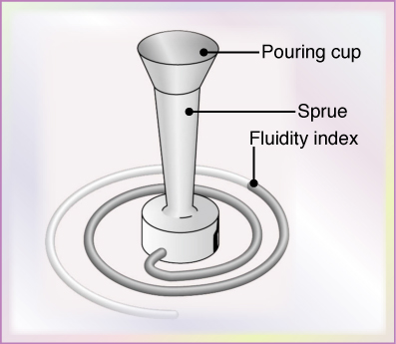
Tests for Fluidity
A test method for fluidity using a spiral mold, the fluidity index is the length of the solidified metal in the spiral passage. | Several tests have been developed to quantify fluidity, although none is accepted universally. In one such common test, the molten metal is made to flow along a channel that is at room temperature; the distance the metal flows before it solidifies and stops flowing is a measure of its fluidity. This length is a function of the thermal properties of the metal and the mold, as well as of the design of the channel.

Slide 29
Heat Transfer
The heat transfer during the complete cycle (from pouring, to solidification and to cooling to room temperature) is another important consideration in metal casting. Heat flow at different locations in the system is a complex phenomenon and depends on several factors relating to the material cast and the mold and process parameters.
For instance, in casting thin sections, the metal flow rates must be high enough to avoid premature chilling and solidification. On the other hand, the flow rate must not be so high as to cause excessive turbulence with its detrimental effects on the casting process.

Slide 30
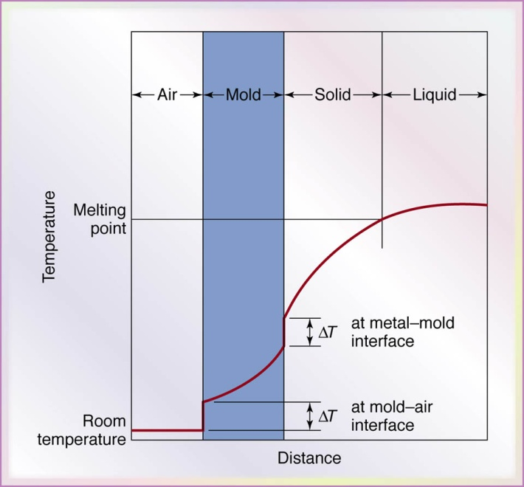
Temperature distributions at the interface of the mold wall and the liquid metal during the solidification of metals in casting. | A typical temperature distribution at the mold liquid-metal interface is shown in Figure. Heat from the liquid metal is given off through the mold wall and to the surrounding air. The temperature drop at the air-mold and mold-metal interfaces is caused by the presence of boundary layers and imperfect contact at these interfaces. The shape of the curve depends on the thermal properties of the molten metal and the mold.

Slide 31

Solidification Time
During the early stages of solidification, a thin skin begins to form at the relatively cool mold walls and as time passes, the thickness of the skin increases. The solidification time is a function of the volume of a casting and its surface:
Where C is a constant that reflects (a) the mold material, (b) the metal properties and (c) the temperature, the parameter n has a value between 1.5 and 2, but usually is taken as 2.

Slide 32
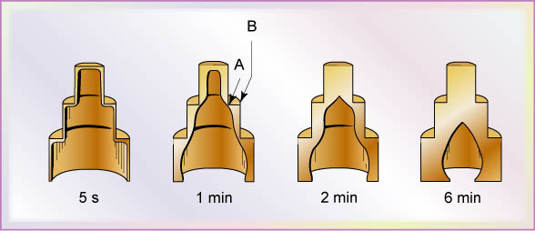
Solidified skin on a steel casting, the remaining molten metal is poured out at the times indicated in the figure. Hollow ornamental and decorative objects are made by a process called slush casting, which is based on this principle. The skin thickness increases with elapsed time and the skin is thinner at internal angles (location A in the figure) than at external angles (location B). The latter condition is caused by slower cooling at internal angles than at external angles.

Slide 33
Shrinkage
Metals usually shrink (contract) during solidification due to their thermal expansion characteristics and while cooling to room temperature. Shrinkage, which causes dimensional changes and sometimes warping and cracking, is the result of the following three sequential events:
Contraction of the molten metal as it cools prior to its solidification.
Contraction of the metal during phase change from liquid to solid (latent heat of fusion).
Contraction of the solidified metal (the casting) as its temperature drops to ambient temperature.

Slide 34
The largest potential amount of shrinkage occurs during the cooling of the casting to ambient temperature. The amount of contraction during the solidification of various metals is shown in Table.
Volumetric Solidification Contraction or Expansion for Various Cast Metals
Contraction (%) |  | Expansion (%)
Aluminum | 7.1 | Bismuth | 3.3
Zinc | 6.5 | Silicon | 2.9
Al-4.5% Cu | 6.3 | Gray Cast Iron | 2.5
Gold | 5.5
White Iron | 4 - 5.5
Copper | 4.9
Brass (70 - 30) | 4.5
Magnesium | 4.2
90% Cu - 10% Al | 4
Carbon Steel | 2.5 - 4
Al - 12% Si | 3.8
Lead | 3.2

Slide 35
Casting Defects
Casting Defects: International Committee of Foundry Technical Associations has developed a standardized nomenclature consisting of seven basic categories of casting defects, identified with boldface capital letters:
A-Metallic projections, consisting of fins, flash or projections such as swells and rough surfaces.
B-Cavities, consisting of rounded or rough internal or exposed cavities including blowholes, pinholes and shrinkage cavities.
C-Discontinuities, such as cracks, cold or hot tearing, and cold shuts. If the solidifying metal is constrained from shrinking freely, cracking and tearing may occur. Although several factors are involved in tearing, coarse grain size and the presence of low-melting-point segregates along the grain boundaries (intergranular) increase the tendency for hot tearing. Cold shut is an interface in a casting that lacks complete fusion because of the meeting of two streams of liquid metal from different gates.

Slide 36
D-Defective surface, such as surface folds, laps, scars, adhering sand layers, and oxide scale.
E-Incomplete casting, such as misruns (due to premature solidification), insufficient volume of the metal poured, and runout (due to loss of metal from the mold after pouring). Incomplete castings also can result from the molten metal being at too low a temperature or from pouring the metal too slowly.
F-Incorrect dimensions or shape, due to factors such as improper shrinkage allowance, pattern-mounting error, irregular contraction, deformed pattern or Warped casting.

Slide 37
G-Inclusions, Which form during melting, solidification, and molding; these are generally nonmetallic. They are regarded as harmful because they act as stress raisers and thus reduce the strength of the casting. Inclusions may form during melting when the molten metal reacts with the environment (usually oxygen) or with the Crucible or mold material.
Chemical reactions among components in the molten metal itself may produce inclusions; slags and other foreign material entrapped in the molten metal also become inclusions, although filtering can remove particles as small as 30 µm. Finally, spalling of the mold and core surfaces can produce inclusions, thus indicating the importance of the quality of molds and of their maintenance.

Slide 38
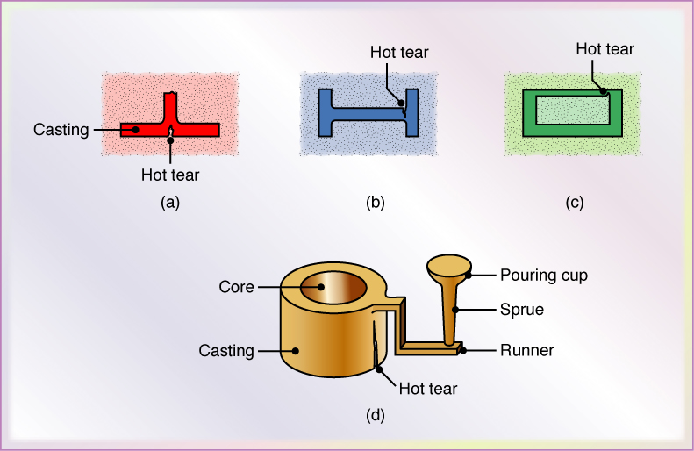
Hot Tears in Castings
Examples of hot tears in castings. These defects occur because the casting cannot shrink freely during cooling, owing to constraints in various portions of the molds and cores. Exothermic (heat-producing) compounds may be used (as exothermic padding) to control cooling at critical sections to avoid hot tearing

Slide 39
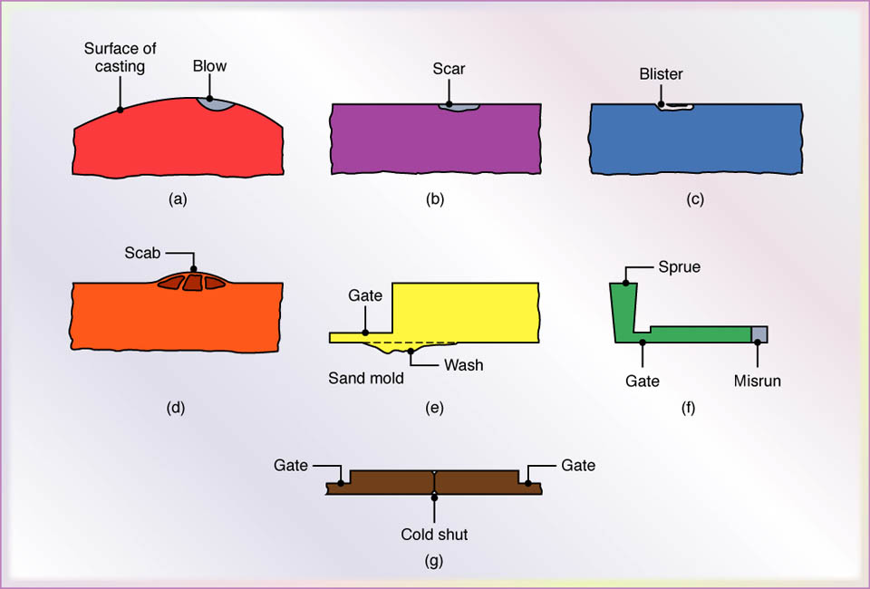
Common Casting Defects
Examples of common defects in castings. These defects can be minimized or eliminated by proper design and preparation of molds and control of pouring procedures.

Slide 40
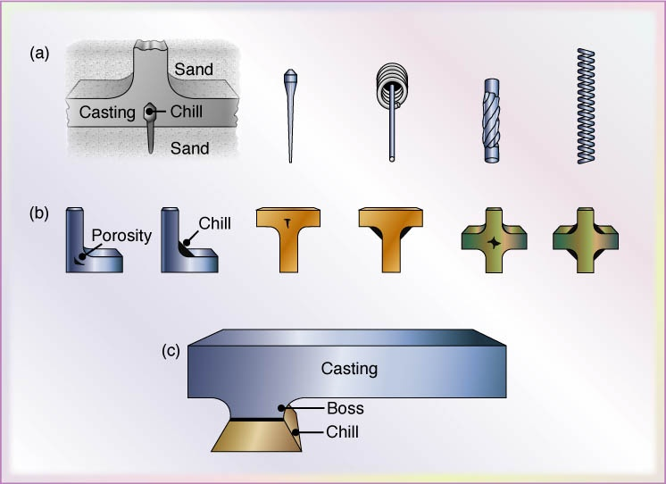
Types of Internal and External Chills used in Casting
Various types of (a) internal and (b) external chills (dark areas at corners) used in castings to eliminate porosity caused by shrinkage. Chills are placed in regions where there is a larger volume of metal, as shown in (c).

